Slide 1
Why Do We need Community in our Research?
with University Friends Circle on February 4, 2025

Slide 2
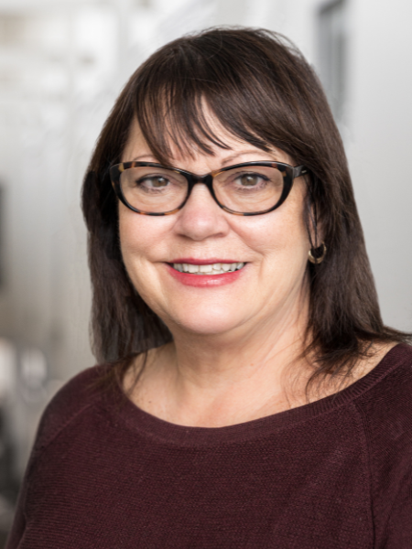
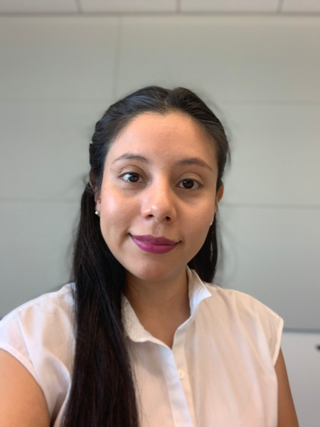
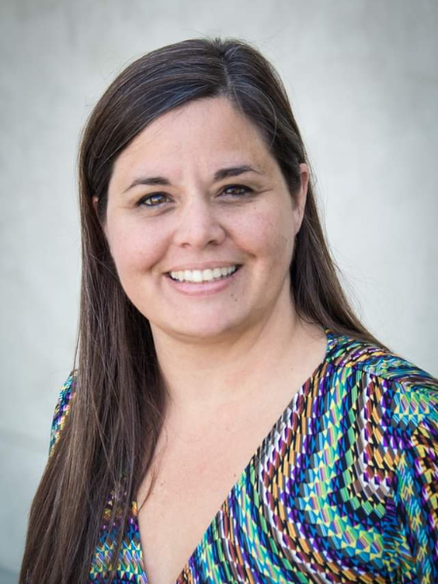
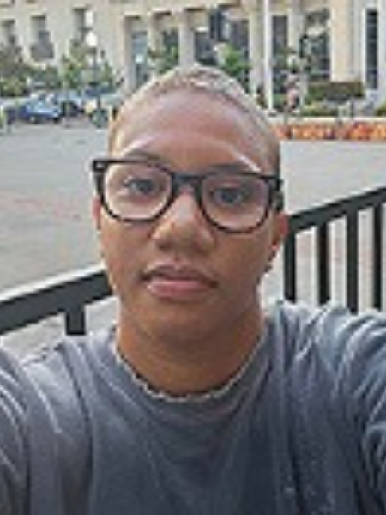
Featured Speakers
Robin DeLugan
Professor of Anthropology & Interim Chair of the Interdisciplinary Humanities Graduate Group, UC Merced
Miriam Campos Martínez
Interdisciplinary Humanities PhD Graduate Student, UC Merced
Christina Lux
Managing Director of the Center for the Humanities, UC Merced
Samantha Almeida
Interdisciplinary Humanities PhD Graduate Student, UC Merced

Slide 3
Interdisciplinary Humanities Graduate Group and Luce Initiative Background
We transform graduate education in three ways
Community involvement
Faculty and Graduate Teamwork
Project based learning

Slide 4
Presentation Outline
What is community-engaged research about and why is it important?
What kinds of projects have student and community teams engaged so far?
What is current work and highlights, from a student perspective?
What is ahead and new on the horizon?

Slide 5
Continuum of Community-Engaged Research
Notes:
Balazs and Morello Frosch
The role of community members in research can vary. In traditional research”/”helicopter science”, the local context is not considered nor does the local community have influence on the research question or design.
In Community Engaged Research (here “CBPR”) the role of community members increases: they might participate in research design, might be involved with pre and post data collection, and might also participate in the dissemination of results. This transforms community members from a “study participant” to a “Research partners” that share in the doing, interpreting, and acting on research. ANY QUESTIONS ABOUT THIS ILLUSTRATION?
While these are not brand new approaches to research…they are new for research intensive universities such as UCM
…our new campus has the oppty to develop

Slide 6
Example 1: Linguistic Landscapes
Project Leads: Dr. Yiran Xu, Assistant Professor of Writing Studies and Dr. Jiajun Liang, Assistant Professor of Media Studies
Community Partner: Merced County Courthouse Museum
Project Focus: The linguistic landscape of Merced and how it reflects its inherent language diversity
Project Goal: Archive and exhibit Merced's linguistic diversity through archival research, photography of multilingual signage, and interviews with local business owners

Slide 7
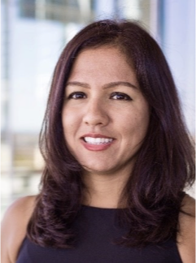
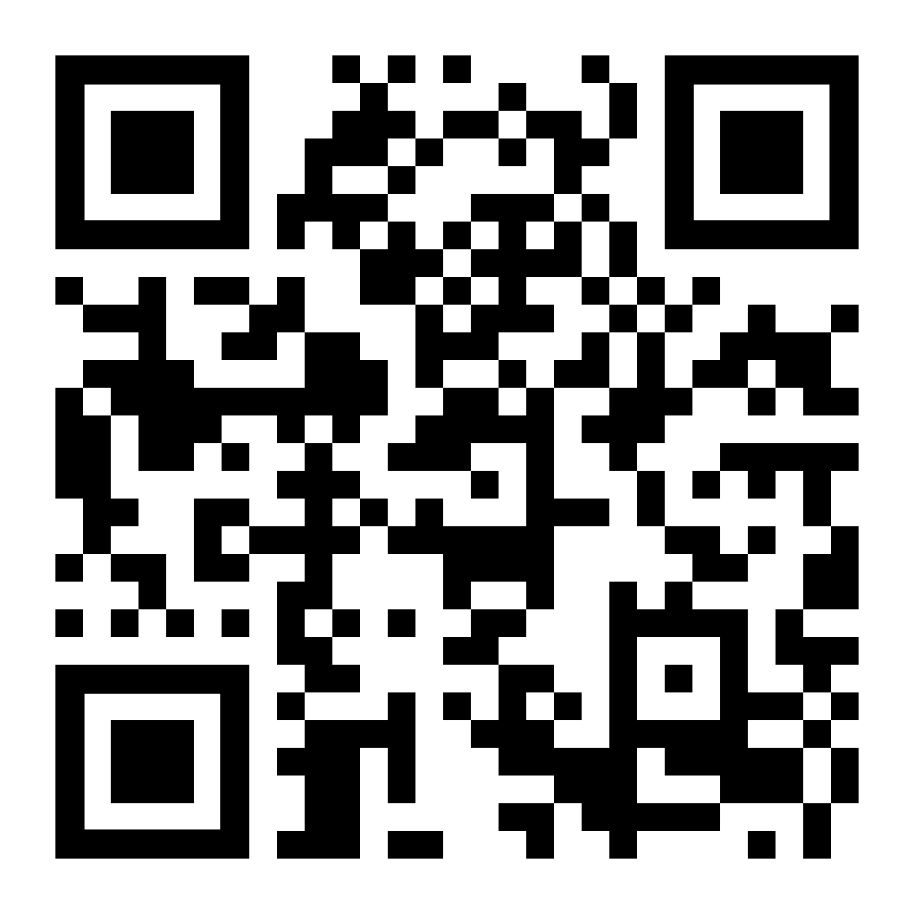
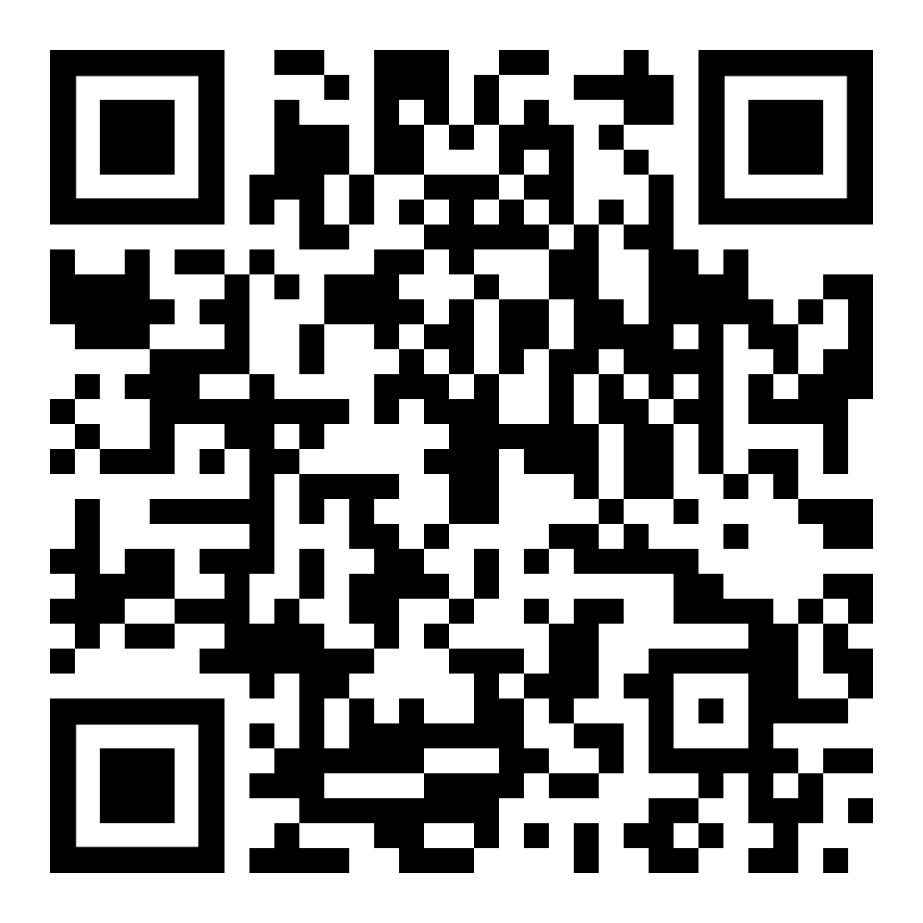
Example 2: Medical Humanities in Planada
Project Lead: Dr. Dalia Magaña, Professor of Spanish Linguistics
Community Partner: Healthy House
Project Focus: Spanish language communication in medical, educational, and social contexts
Project Goal: Aims to raise awareness about the role of language use and cultural competency in improving patient-centered healthcare with Spanish speakers
Healthy House website
Dalia Magaña’s website

Slide 8
Panel Discussion with Graduate Students
What have you learned about research by doing community-engaged projects? What are some important skills, for example?
How was community at the center of your research projects? Why was that important?
What do you wish were taught more or offered more as educational opportunities around community-engaged research?

Slide 9
Our Interwoven Futures
3-Year Grant
Sub-Themes include:
Risk, Durable Justice, and Reconciliation
Transformative Communities of Care and Mutual Aid
Migrations, Diasporas, and the Future of Cultural Revitalization
Designing Responses to Climate Impacts - from Wildfires to Floods
Provides fellowships to create public humanities projects
that engage our region, with a focus on Merced County and beyond
with a social justice orientation
Offers regular touchpoints between the campus and community
2 community lunch conversations annually
200 books for a “Common Read” with 10 book club discussions, in partnership with the Merced County Library
Funds workshops, trainings, and sharing examples of public humanities projects
1-day public humanities boot camp annually
3 public humanities speakers annually
Mass media trainings, currently in partnership with the Central Valley Journalism Collaborative

Slide 10
How to Get Involved
Community Lunches
Common Read
Fellowships
Workshops & Talks
Contact Us

Slide 11
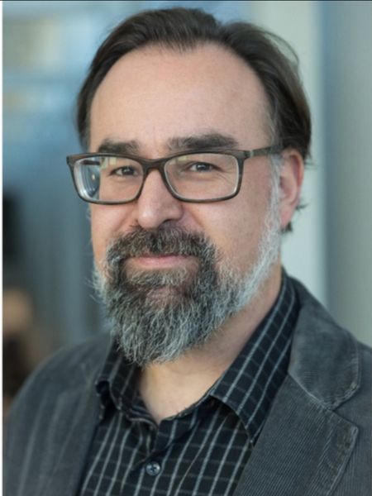
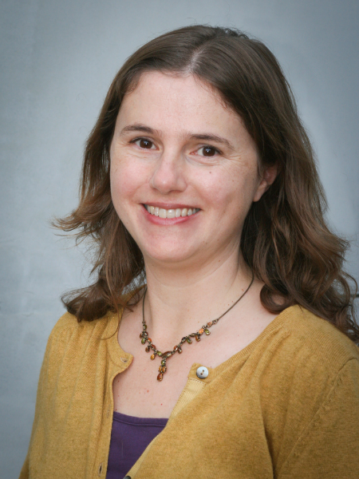
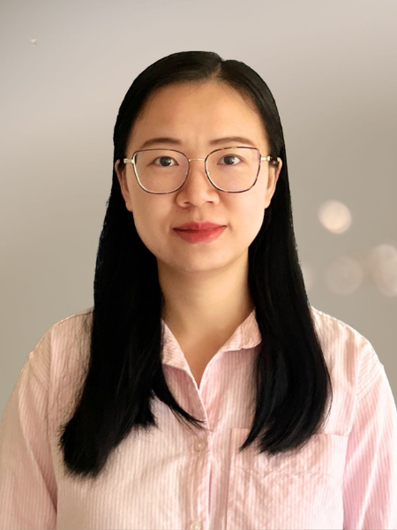
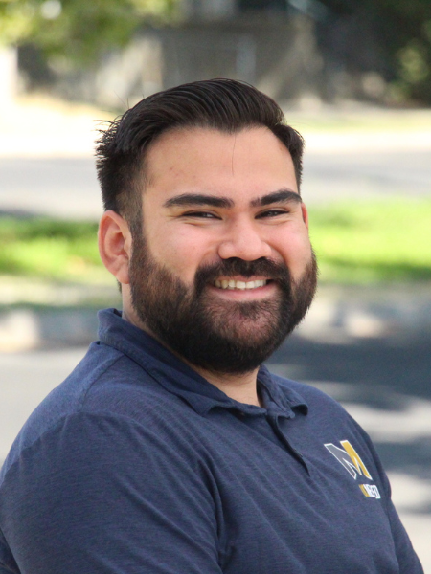
Our Additional Team Members Here Today
Ignacio López-Calvo
Professor of Literature & Faculty Director of the Center for the Humanities UC Merced
Anne Zanzucchi
Teaching Professor for Writing Studies & Associate Dean
UC Merced
Man Zhang
Staff Research Associate for "Our Interwoven Futures" Andrew Mellon Grant
UC Merced
Martin Ojeda
Staff Research Associate for the "Stroger Together"
Henry Luce Initiative
UC Merced
​

